Slide 1
Chapter 8 Surface Area of 3D Solids

Slide 2
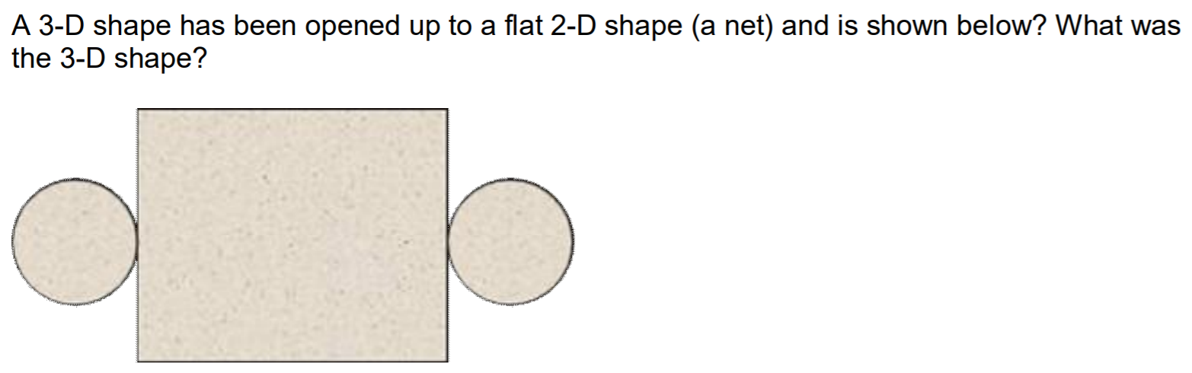
Rectangular Prism
Cube
Cylinder
Triangular Prism
Sphere

Slide 3
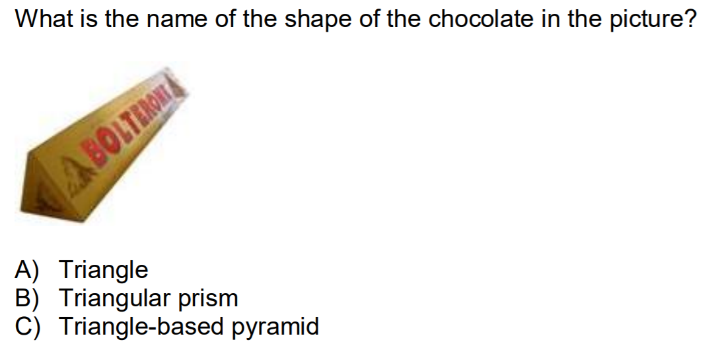

Slide 4
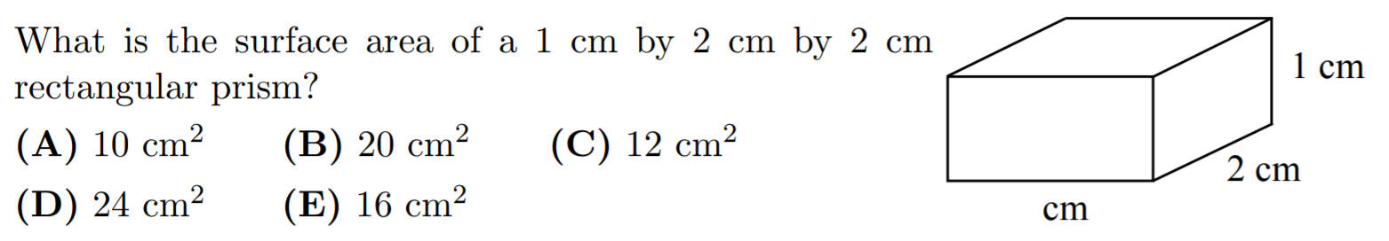

Slide 5
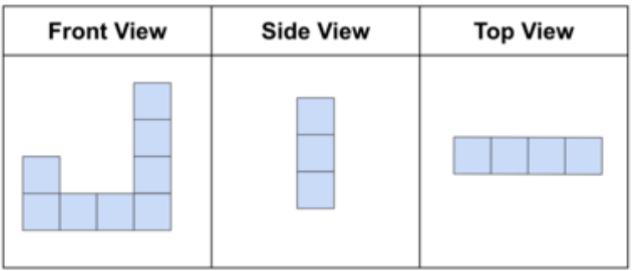
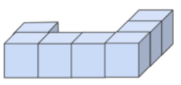
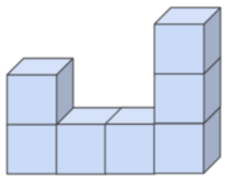
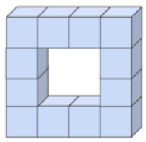

Given the 3 sides of a solid, indicate which solid corresponds with these views?
a) b) c) d)

Slide 6
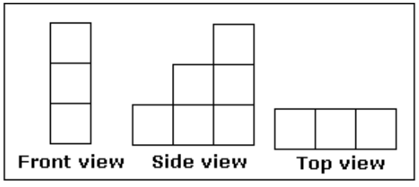
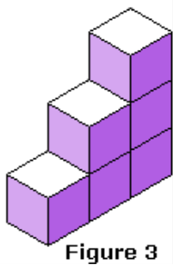
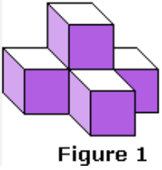
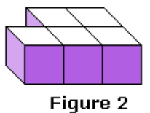
Q: Given the 3 views of the 3D solid, indicate which solid corresponds with these views:
a) b) c)

Slide 7
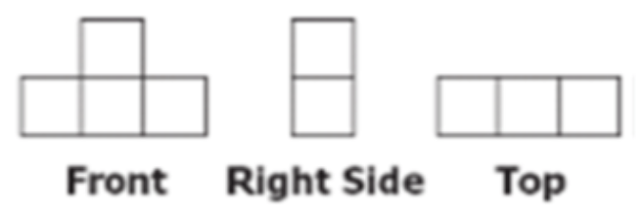
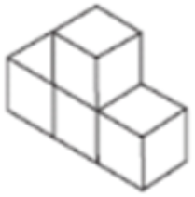
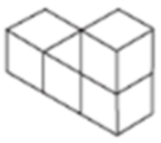
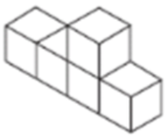
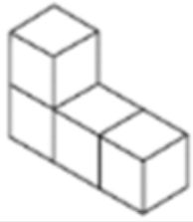
Q: Given the 3 sides of a 3D solid, indicate which object correspond with the views?
a) b) c) D)

Slide 8
Given the Front, Side, and Top views of a solid, what is the name of this 3D Solid?
Front
Top
Right
Pyramid
Rectangular Prism
Cone
Cylinder
SPhere

Slide 9
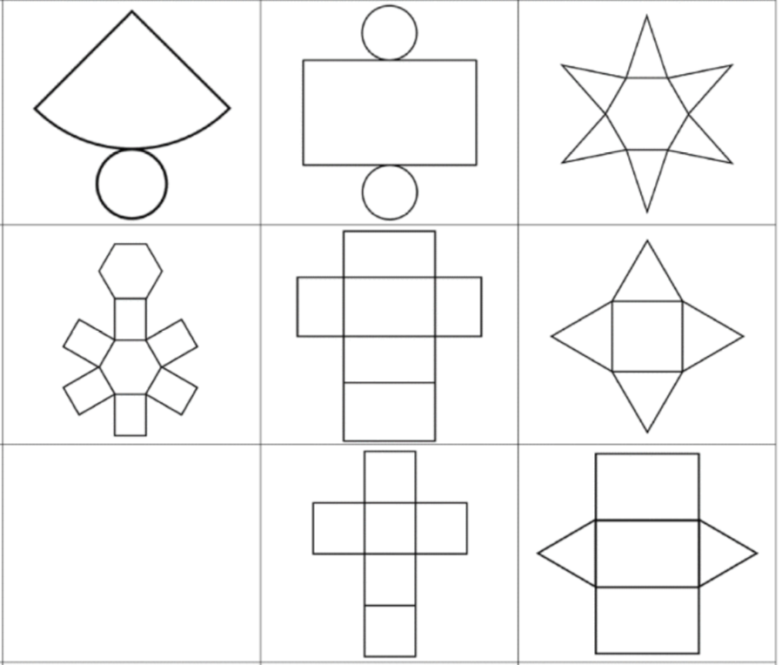
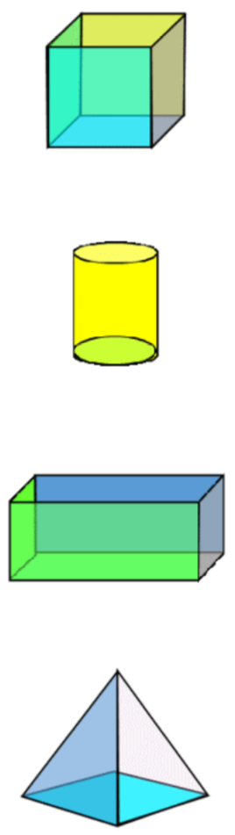
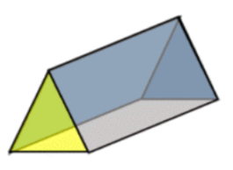
Match each solid with the net shown on the right:
1)
2)
3
A)
B
4)
5)
6
C
7)
8
D

Slide 10
The following images shows two different views of a dice. Which of the following may be a net of the dice?
A
C
B
D

Slide 11
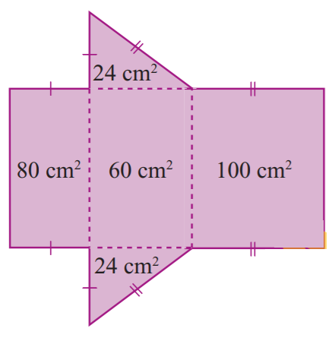
Given the net of the solid shown, what is the surface area of the solid?
264 cm²
232 cm²
324cm²
288cm²
380cm²

Slide 12
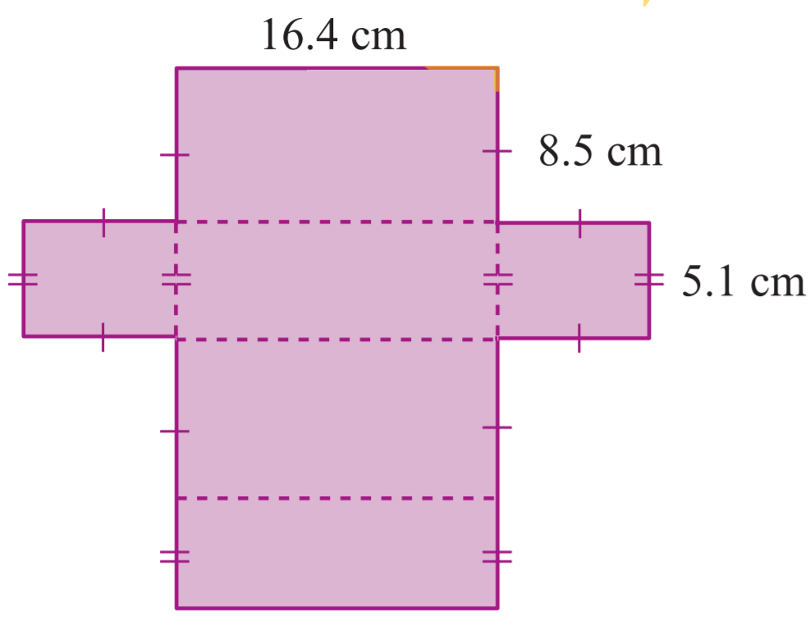
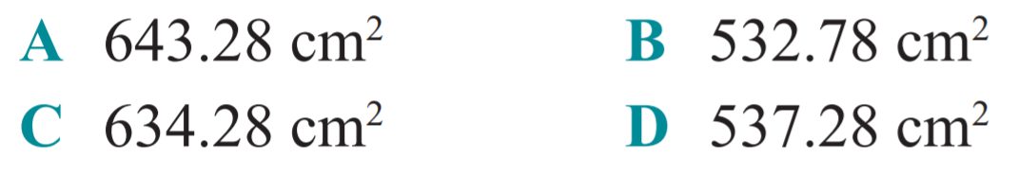
Given the net of the solid shown, what is the surface area of the solid?

Slide 13
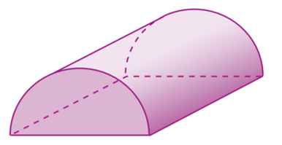
Which of the following are the Front, Side, and Top Views of the solid shown below?
Front
Top
Right
Top
A
Right
B
Front
C
D

Slide 14
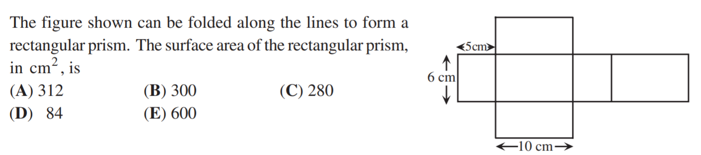

Slide 15

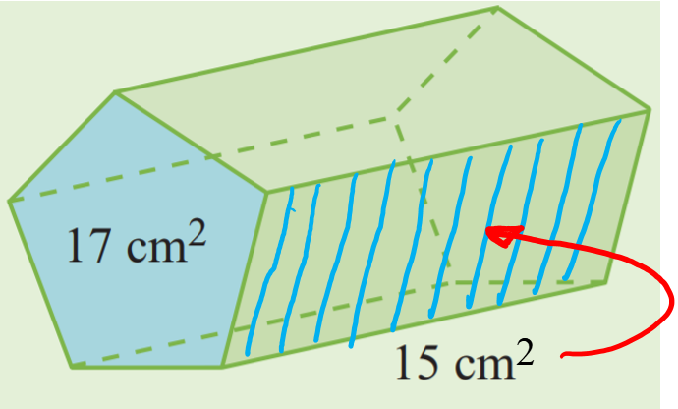
17x15 cm²
2x15x17 cm²
17x2+15x5 cm²
15+17 cm²
17 + 17 + 15 + 15 cm²

Slide 16
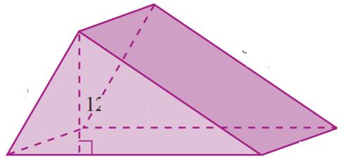
Which of the following best describes the surface area of the 3D Solid shown below?
Two Triangles and a rectangle
Two Triangles and 2 rectangles
Three Triangles and 3 rectangles
Four Triangles and 2 Squares
Two Triangles and 3 Rectangles

Slide 17
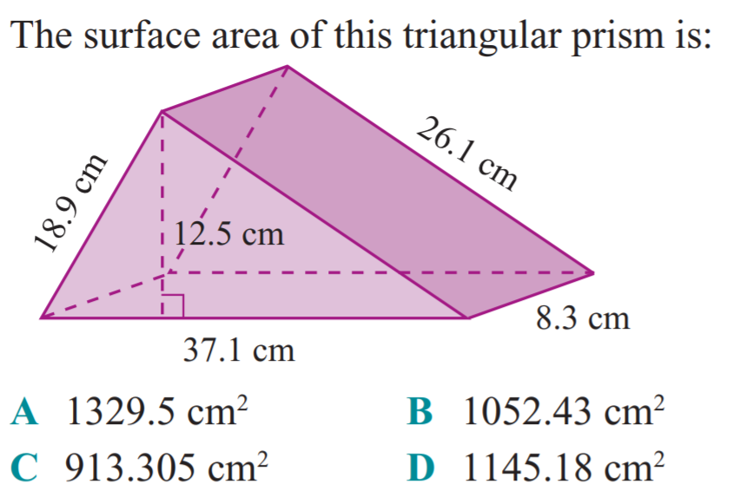

Slide 18
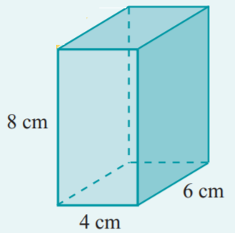
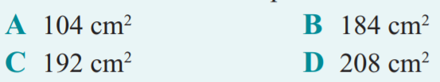

Slide 19
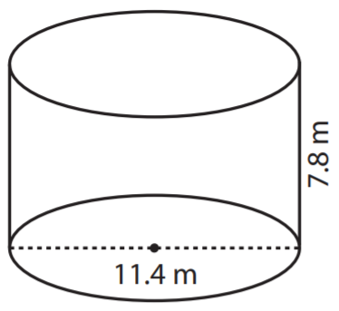
What is the radius and height of this cylinder?

Slide 20
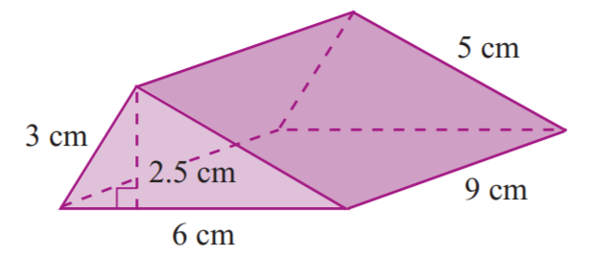
25.5 cm²
51 cm²
126 cm²
141 cm²
151 cm²

Slide 21
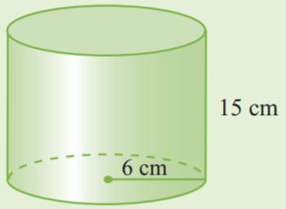
252π cm²
278 π cm²
288 π cm²
348 π cm²
352 π cm²

Slide 22
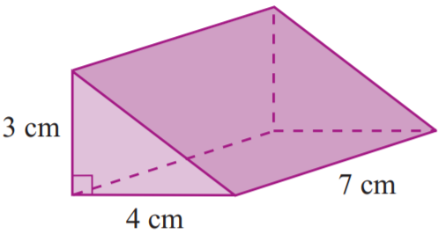
14 cm²
84 π cm²
96 cm²
90 cm²
108 cm²

Slide 23
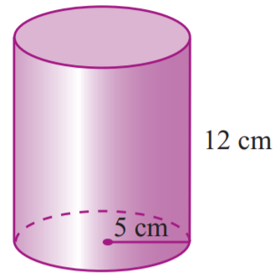
120π cm²
170π cm²
125 π cm²
240π cm²
533π cm²

Slide 24
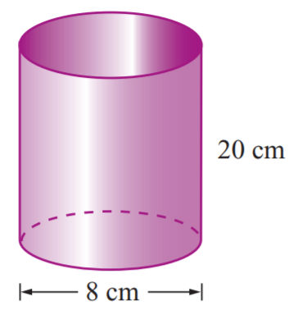
32 cm²
160π cm²
192 cm²
192π cm²
176π cm²

Slide 25
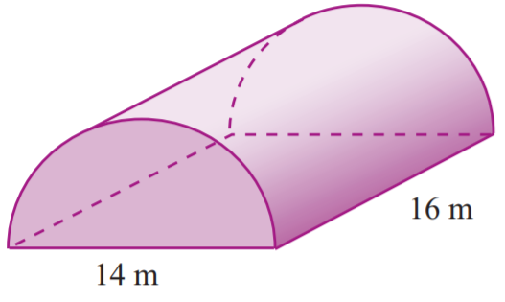
224 cm²
98 π + 224 cm²
273π +224 cm²
322π cm²
161π + 224 cm²

Slide 26
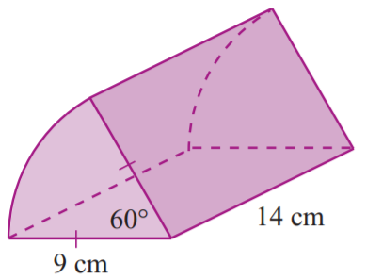
216.77 cm²
69π + 126 cm²
42π + 252 cm²
69π + 252 cm²
49π + 252 cm²

Slide 27
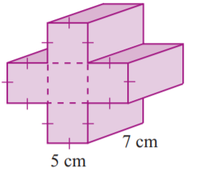
What is the surface area of this solid?
1500 cm²
1350 cm²
670 cm²
890 cm²
620 cm²

Slide 28
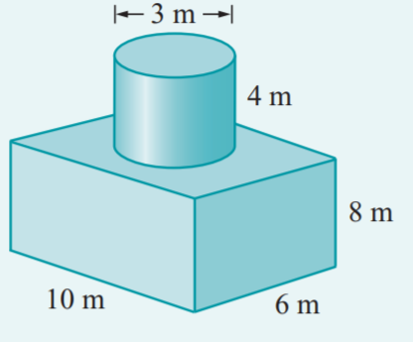
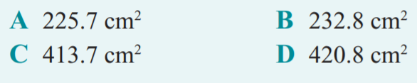

Slide 29
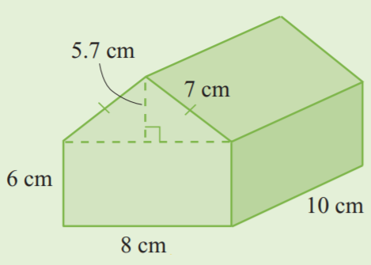
294 cm²
334.3 cm²
388.2cm²
481.6cm²
516.2cm²

Slide 30
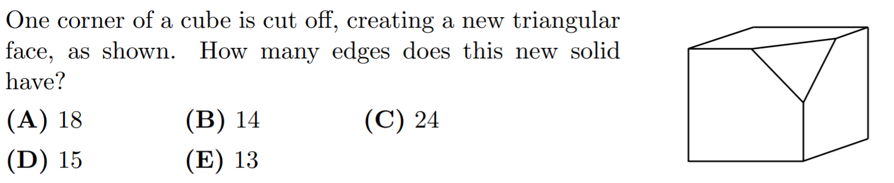

Slide 31
The front, top and right views of a 3D solid are given below. Which of the following 3D solids corresponds with the views?
Front
Top
Right
a) b) c) D) e)

Slide 32
Which of the following 3D views are the correct for the 3D Solid Shown?
c)
a)
Front
Top
Right
Front
Top
Right
D)
b)
Front
Top
Right
Front
Top
Right

Slide 33
Q: What is the surface area of the solid?
256 cm²
304 cm²
352 cm²
384 cm²
412 cm²

Slide 34
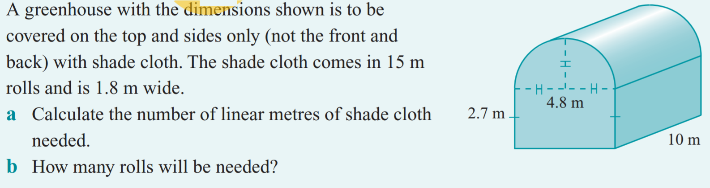

Slide 35
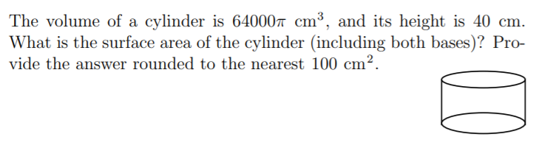

Slide 36
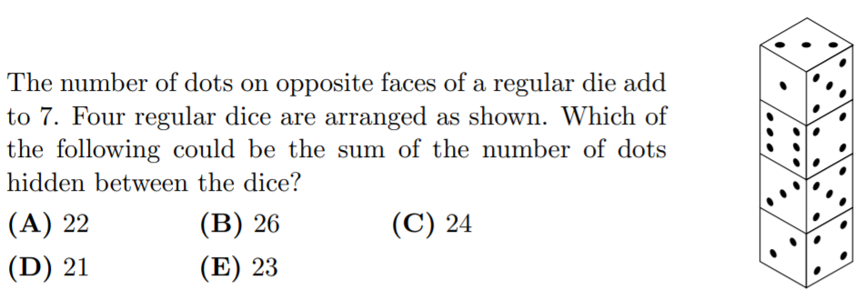

Slide 37
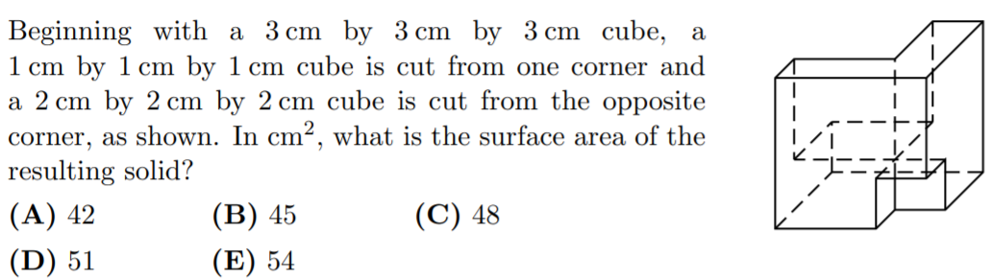

Slide 38
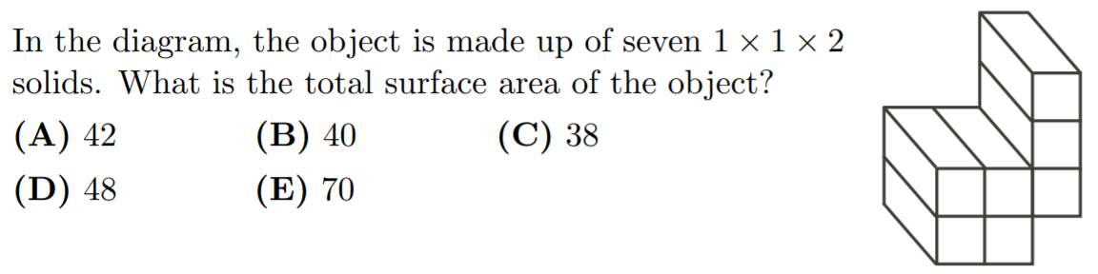

Slide 39
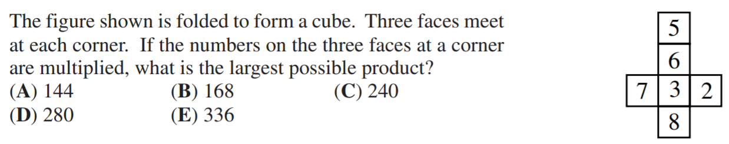

Slide 40
